Slide 1
The American West
US History

Slide 2
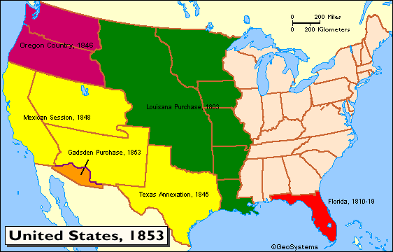
Pre-Civil War US

Slide 3
US in 1877
Manifest Destiny fulfilled by 1853 (bought or acquired all land in the continental US)
Purchased Alaska from the Russians in 1867 ($7.2 million)
Civil War was distraction from Gold Rush and westward immigration
Reconstruction – people were struggling in the day to day; some people moved west to escape

Slide 4
How did the West close?
Migration of poor whites, blacks, immigrants
Mining
Homestead Act
Cattle industry
Railroads

Slide 5
2. Mining Frontier
Gold in CA 1848 started settlement of West
First silver found - Comstock Lode in Nevada (Biggest Western Silver Bonanza)
Mining boom allowed for early statehood (California, Nevada, Idaho, & Montana)

Slide 6
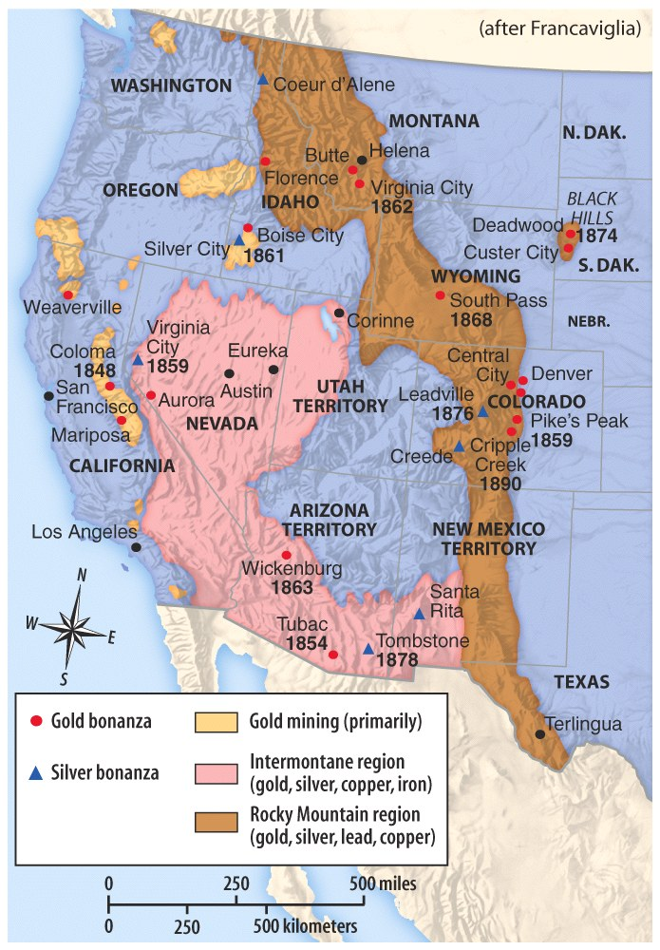

Slide 7
Mining Frontier
Mining towns
Saloons, Prostitutes, etc
Employed experienced miners from around the world
Chinese Immigrant Workers
  Miners
  Built railroads
  Chinese Exclusion Act of 1882 – excluded all Chinese from US; not repealed until 1943

Slide 8
Mining Frontier
Environmental scars still seen today
Continued Native American removal

Slide 9
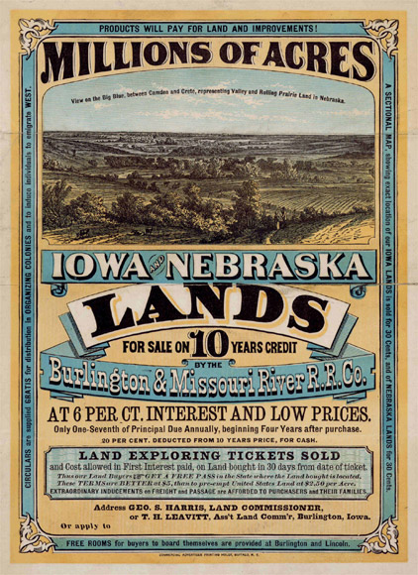
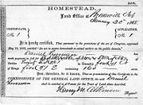
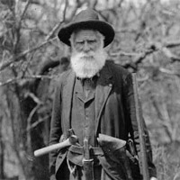
3. The Homestead Act (1862)

Slide 10
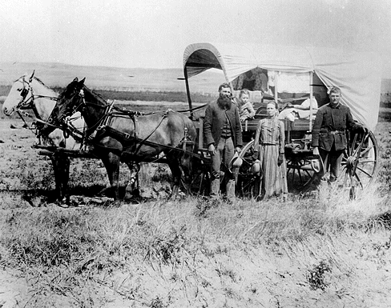
Land Races
http://www.youtube.com/watch?v=5ycMhMM2UFs

Slide 11
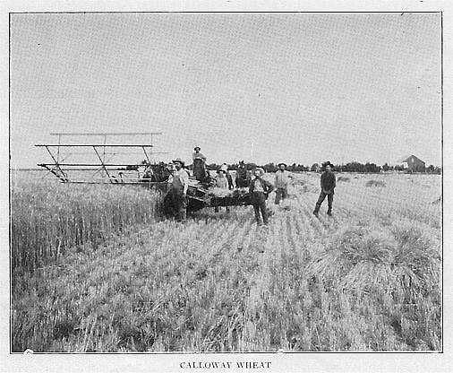
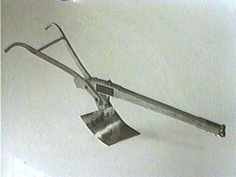
Farming the Plains
Problems:
  Weather extremes
  Plagues
  Water scarcity
  Wood scarcity
Dry farming - dams & irrigation
Created soddies & dugouts for housing

Slide 12
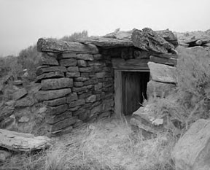
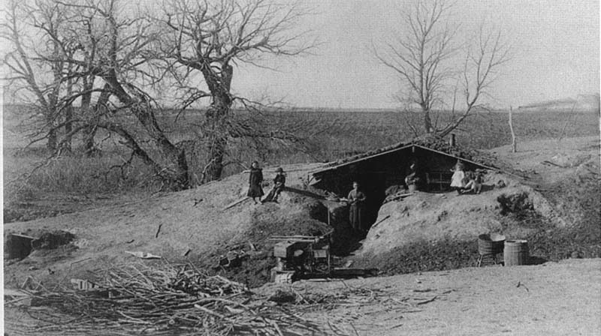
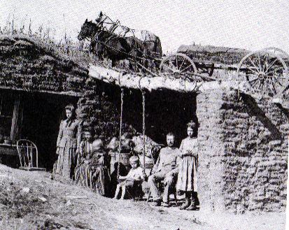
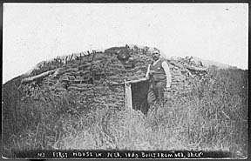
The Dugout

Slide 13
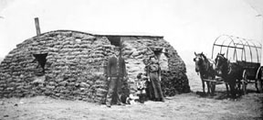
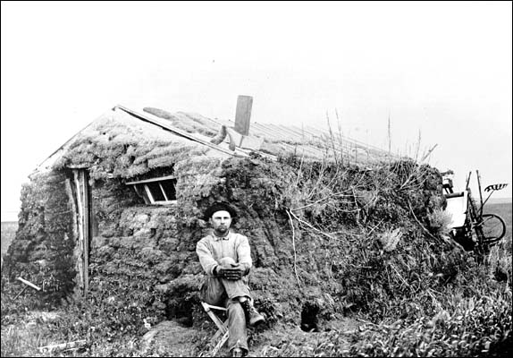
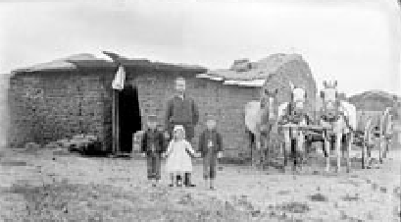
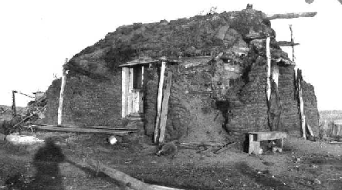
The Soddy

Slide 14
4. Cattle Industry
Traditions & techniques of cattle businessmen “borrowed” from Mexico
Texas longhorn originally came from Mexico
After Civil War: 5 million head of cattle & grassland available for free
Eastern market for Texas cattle (led to longdrives)

Slide 15
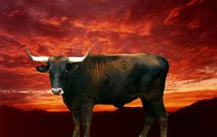
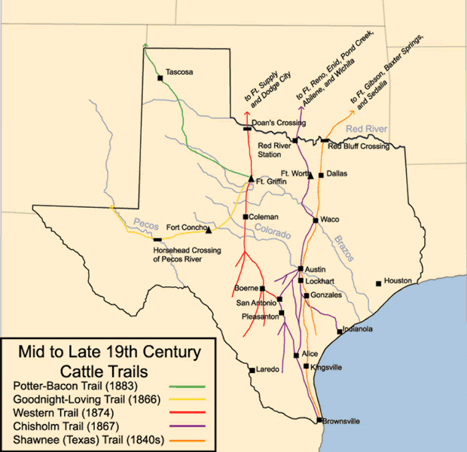
Cattle Trails

Slide 16
Life of a cowboy
Roundup
  spring roundup began the season
  Get cattle together and brand each
  Did not live in towns, or even in homes, but lived outside and moved with the cattle
Long Drive
  trail boss chose crew for long drive to shipping yards
  usually lasted about 3 months
  1 cowboy for 250-300 cattle
  also a cook and a wrangler (cared for the horses)
  in the saddle from dawn till dusk
  slept on the ground, bathed in rivers
  dangers: river crossings, lightning, stampede

Slide 17
Cowboys… myth vs. truth
  25% were African American, 12% were Mexican
  worked 10-14 hours/day on range; 18+ hours on the trail
  average age was 24
  owned own saddle, horse belonged to boss
  expert rider and roper
  if they carried a gun, probably never shot anyone
  worked summer for cattlemen
  banned from drinking, cursing, and gambling
  winters - lived off savings; did odd jobs

Slide 18
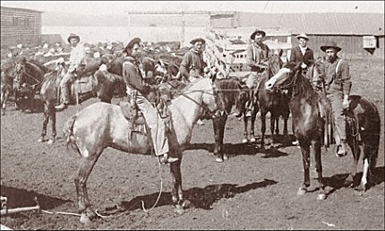
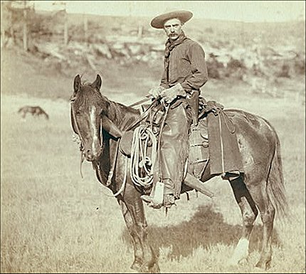
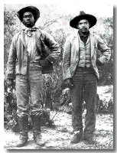
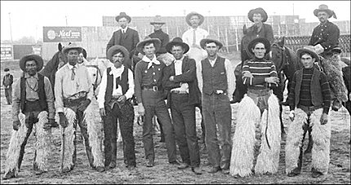
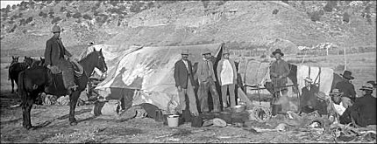

Slide 19
Why no more longdrives?
Three major reasons
  Overgrazing
  Continued natural disasters
  The invention of barbed wire

Slide 20
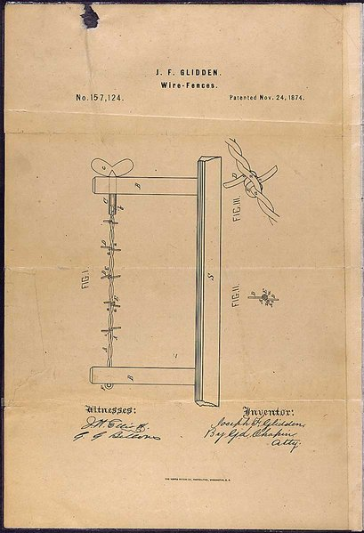
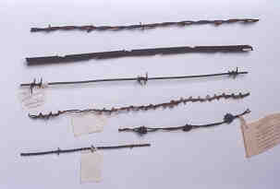
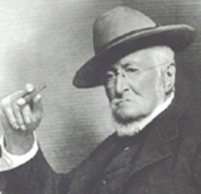
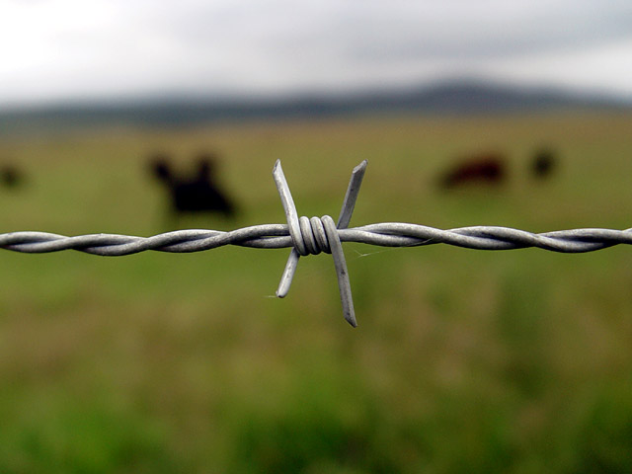
Joseph Glidden (1874)

Slide 21
5. Railroads
The transcontinental railroad (Union Pacific + Central Pacific RR companies)
  Completion of the line in Ogden, Utah (Promontory Point, May 10, 1869)
Made travel and transportation much faster
Gave rise to towns and cities throughout the west
Allowed farmers and ranchers to ship products farther

Slide 22
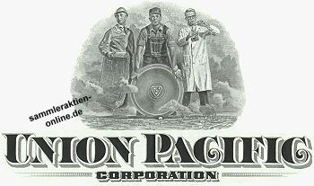
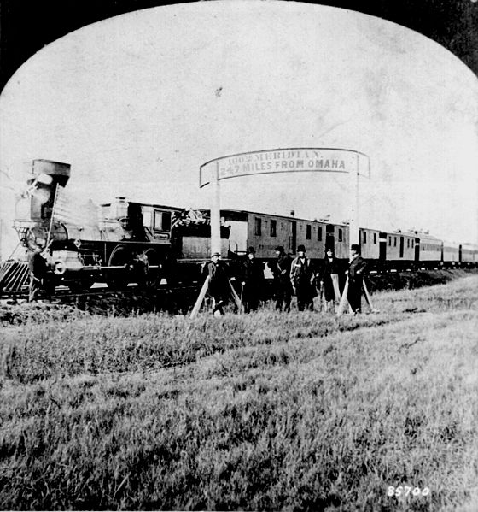
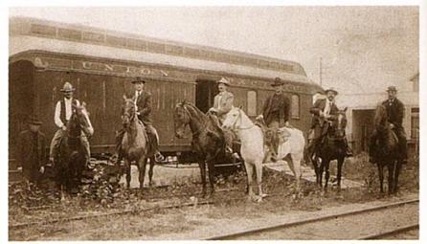

Slide 23
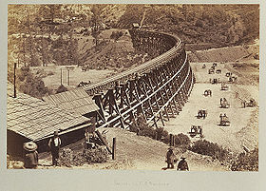
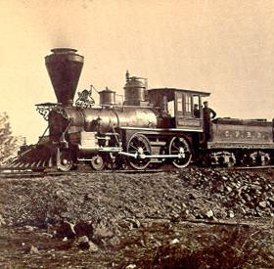
Central Pacific Railroad

Slide 24
Agrarian Discontent
During the Civil War farmers on both sides prospered- food needed for war, fewer farmers and prices went up.
After the War
  Prices tumbled and so did farm income- demand was down so farmers overproduced
  Railroad rates remained high- transportation monopolies
  Farmers needed to borrow money- mortgages, machinery and paying the help until harvest.
  Foreclosures were frequent

Slide 25
Agrarian Discontent
Becoming a minority
  # of US farms more than doubled between 1865-1900
  People working farms declined from 60% to 37%
Farming increasingly commercialized & specialized
Harsh conditions on the Great Plains made farming very difficult

Slide 26
It is 1885. You have saved a little money, and have moved west to become a farmer…

