Slide 1
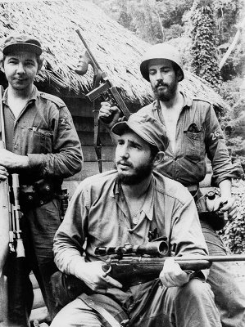
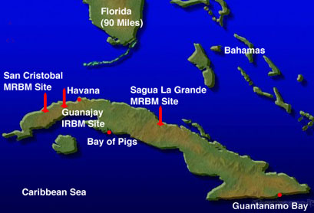
Cuban Revolution (1959)
Fidel Castro leads military revolution in Cuba against dictator Batista (friendly to U.S.)
A Communist country (back by U.S.S.R.) 90 miles from America

Slide 2
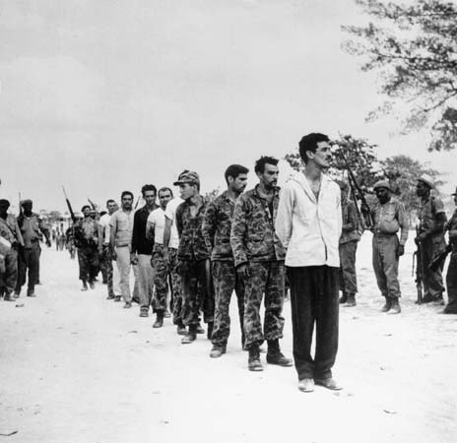
Bay of Pigs
Pres. Kennedy supported the landing of 1,400 armed Cuban rebels to attack Fidel Castro.
They are all killed or captured.
It was a failed attempt to overthrow Castro.

Slide 3
Cuban Missile Crisis (1961)
U.S.S.R. set up nuclear missiles on Cuba.
Pres. Kennedy authorized U.S. naval ships to surround (blockade) the island nation of Cuba
13 days of intense negotiations
U.S. agreed to remove missiles in Turkey & U.S.S.R. agreed to remove missiles from Cuba.
Closest ever to nuclear war.

Slide 4
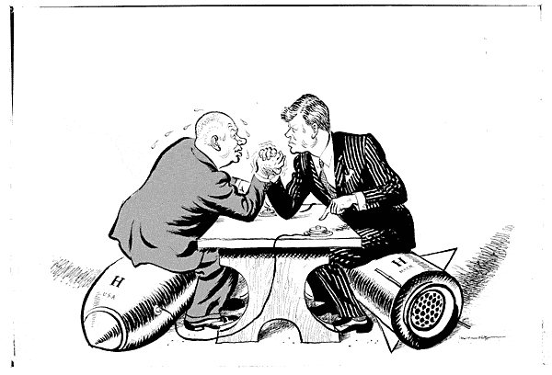

Slide 5
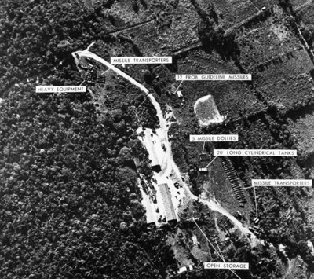
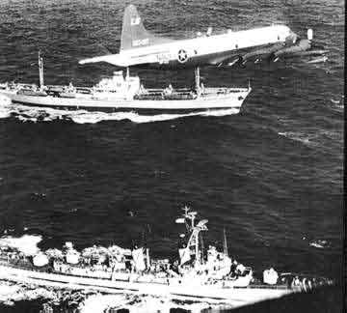

Slide 6
Vietnam War (1954 - 1975)
Ho Chi Minh (communist) wanted Vietnam to be an independent country.
U.S. feared that if Vietnam fell to communism, then all of Southeast Asia might fall as well (Domino Theory).
Gulf of Tonkin Resolution (1964) - after 2 of our
Navy ships were fired on by North Vietnam (our ships were spying!), Pres. Johnson gets Congress to give him the power "to repel any armed attack"

Slide 7
Tet Offensive (Jan. 30, 1968)
360,000 U.S. Troops in Vietnam
Large surprise attack against every U.S. position in Vietnam (Turning point of the War)
Vietnam proved to be a stalemate
Led to end of war with Americans becoming weary of constant images of 58,000 dead Americans

Slide 8
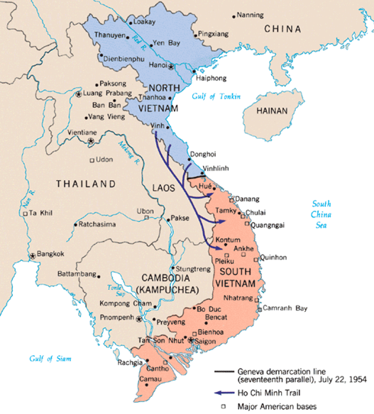

Slide 9
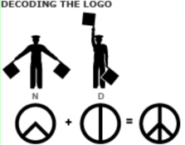
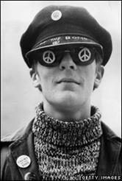
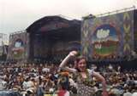
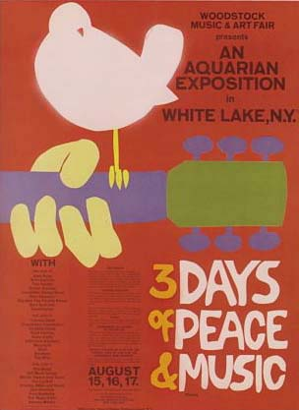
Anti-Vietnam War Movement
After Tet Offensive, Americans anger at so many military deaths
Protests and concerts were stage to tell gov't how the "hippies" felt
nuclear disarmament

Slide 10
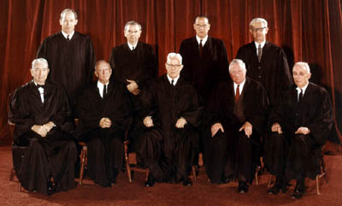
Take a look at the following chart with information from “Major Decisions of the Warren Court, 1954-1967 on p. 900:

Slide 11
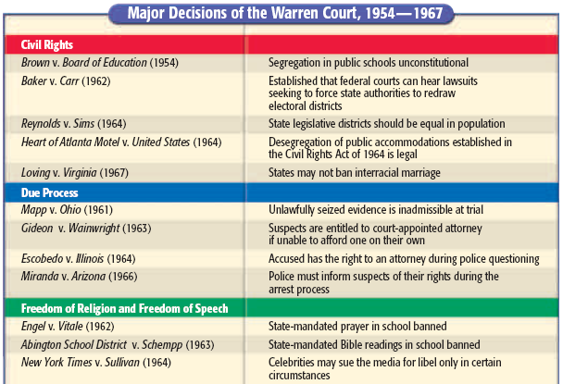
20.
= considered an expansion of our civil rights

Slide 12
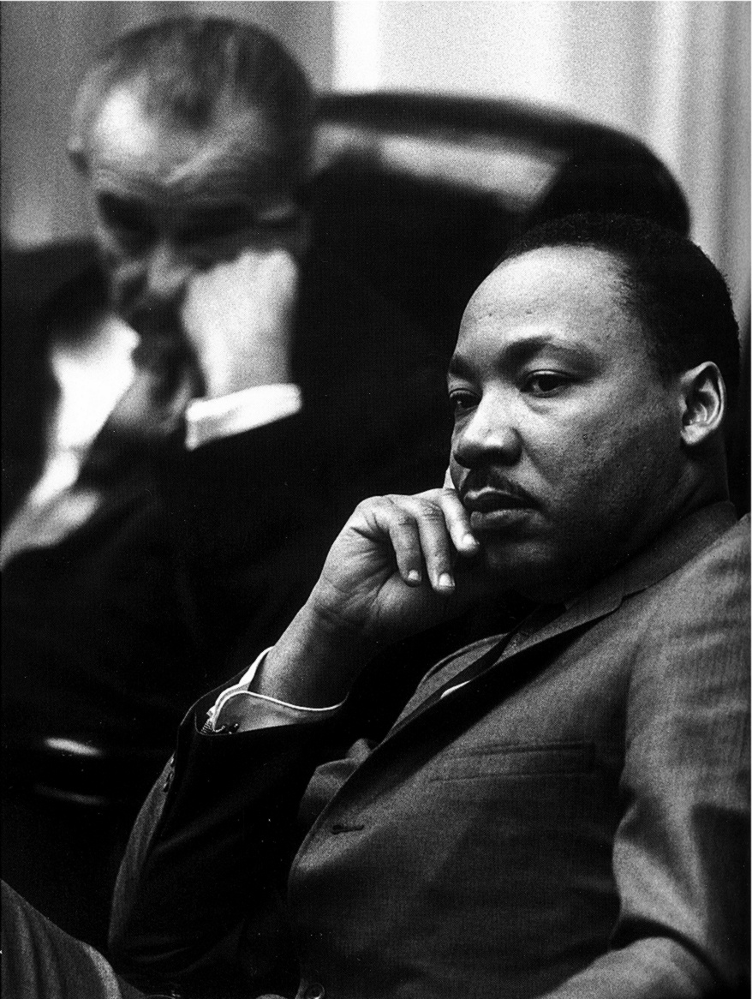
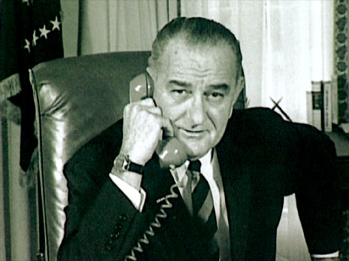
Pres. LBJ's Great Society
After JFK's assassination, Johnson proposed his "War on Poverty" as his domestic plan to help the poor

Slide 13
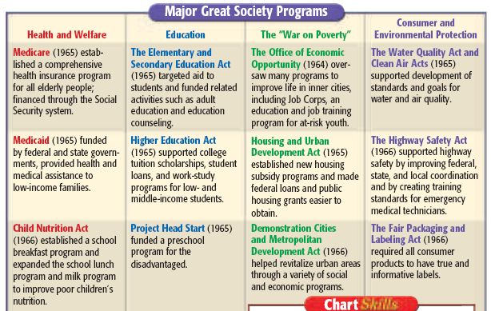

Slide 14
Medicare
LBJ Convinced congress to set up Medicare with it's twin program, Medicaid (both for the elderly and low income) and other programs.

