Slide 1
BA
Explain population density and draw a map that represents an idea of density

Slide 2
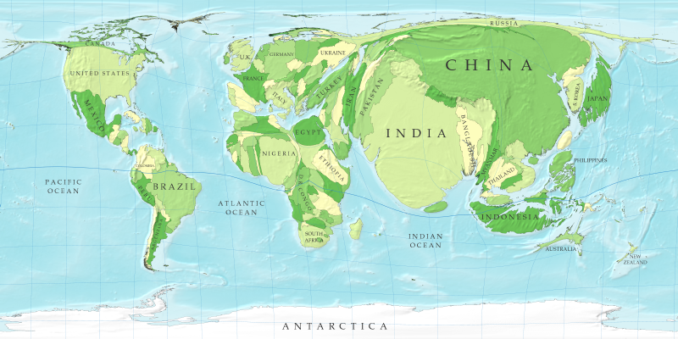
Population: 2-1
Distribution vs. Concentration

Slide 3
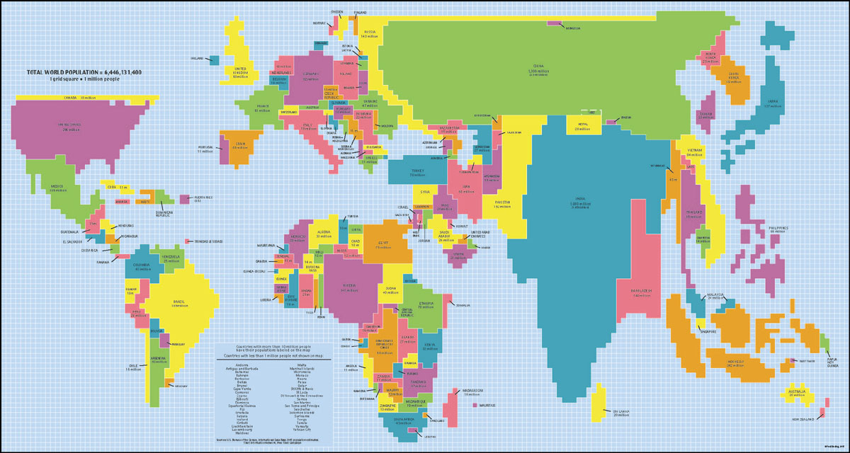
Clusters
Population Clusters are areas where large numbers of people live.
  East Asia (China), South Asia (India), & SE Asia, & Europe
Why here?
  Climate
  Soil
  Water

Slide 4
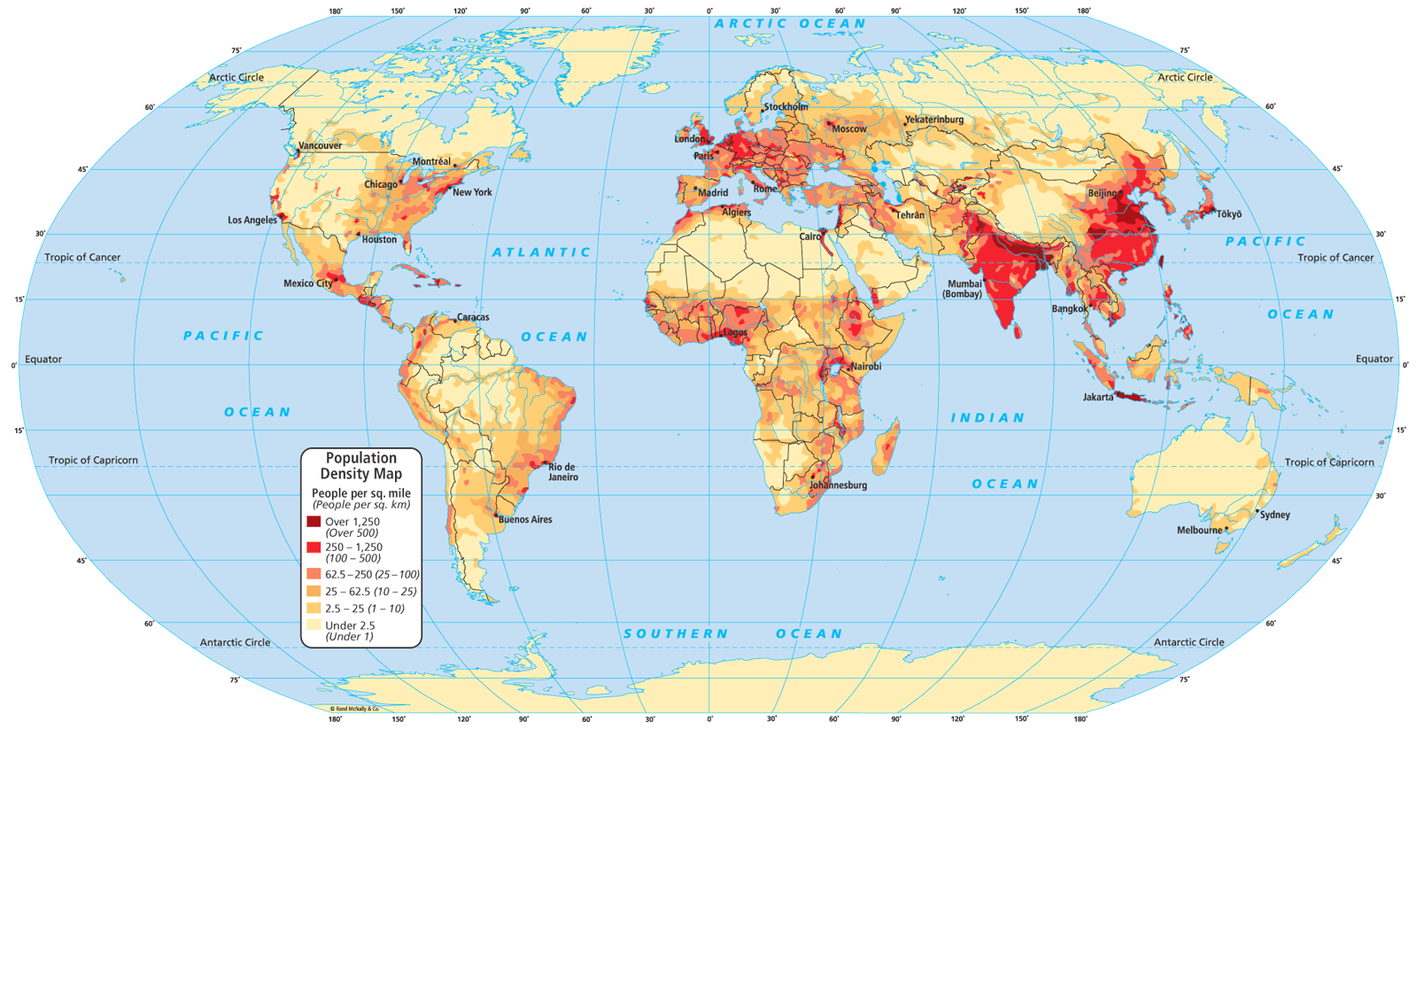
More people live above the equator

Slide 6
66% of the world’s population lives north of the Tropic of Cancer & south of the Arctic Circle.

Slide 7
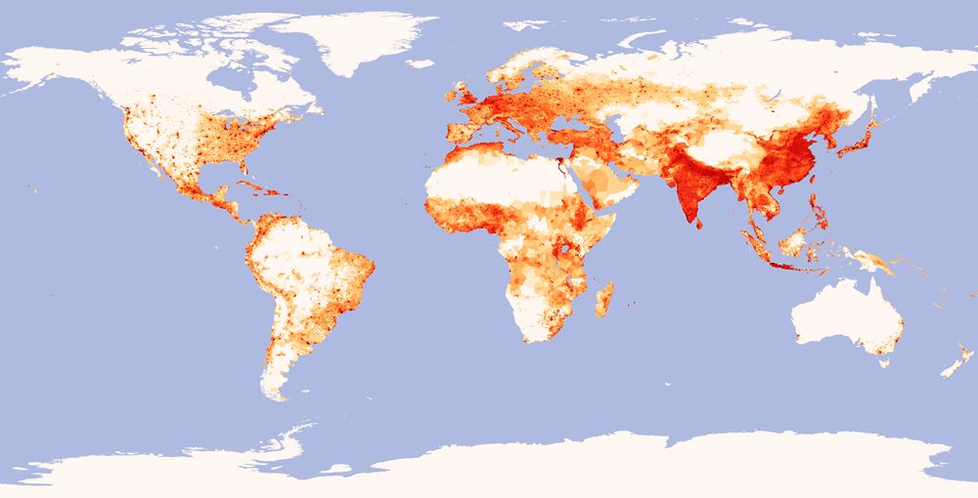
Clusters (cont’d)
E. ASIA
C. EUROPE
N.E. USA
W. AFRICA
S.E. ASIA
S. ASIA

Slide 8
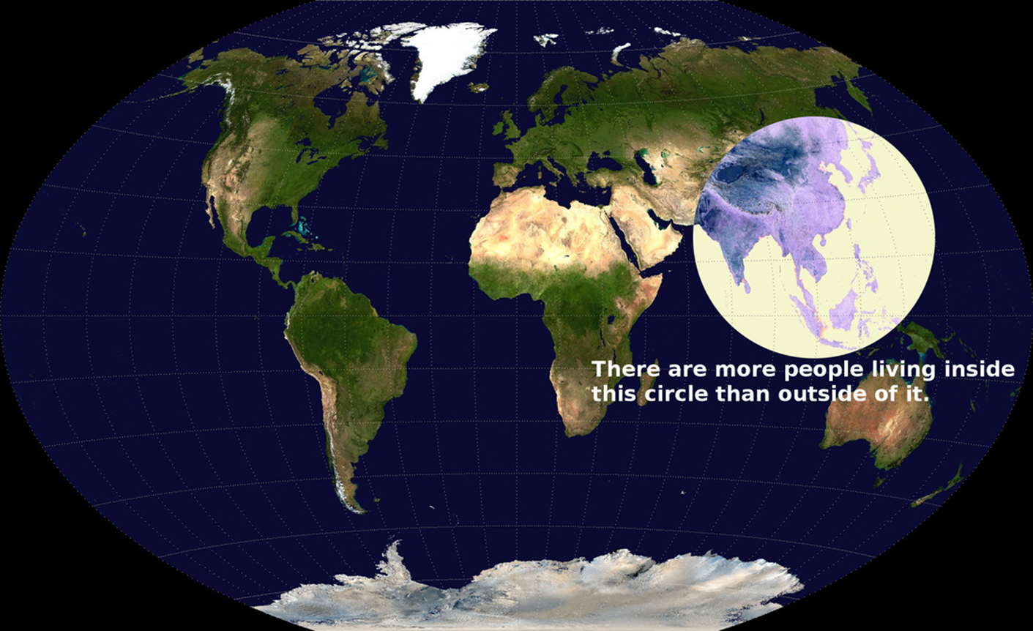

Slide 9
10 Most Populous Countries
8,084,686,889
India (1,463,865,525)
China (1,416,096,094)
USA (347,275,807)
Indonesia (285,721,236)
Pakistan (255,219,554)
Nigeria (237,527,782)
Brazil (212,812,405)
Bangladesh (175,686,899)
Russia (143,997,393)
Ethiopia (135,472,051)

Slide 10
Climate
We avoid places that do not allow agriculture:
  Too dry
  Too wet
  Too cold
  Too mountainous
The regions where humans live (ecumene) are spreading.

Slide 11
Population Density
Arithmetic (Crude) – people/square mile.
  Divide population by the area.
Physiological – people/square mile of arable land.
  Divide population by arable land area.
Agricultural – farmers/square mile of arable land.
  Divide population of farmers by arable land area.

Slide 12
Figure This
USA’s population = 348,302,751 m
USA’s total land area = 3,809,525 m sq. mi.
  90. ppl/sq. mi.
USA’s total arable land = 608,883 sq. mi.
  572 ppl/sq. mi. of arable land
USA’s farming population = 3,486,129M
  5.7 farmers/sq. mi. of arable land

Slide 13
Densities
Most densely populated country?
  Monaco (18,693 ppl/sq. mi.)
Least densely populated country?
  Greenland (.14 ppl/sq. mi.)
  (video)

Slide 14
EA
Complete the Climate Organizer on Google Classroom.
Work on your notes for tomorrow.
Finish the Population Intro Questions of Google Classroom

